Slide 1
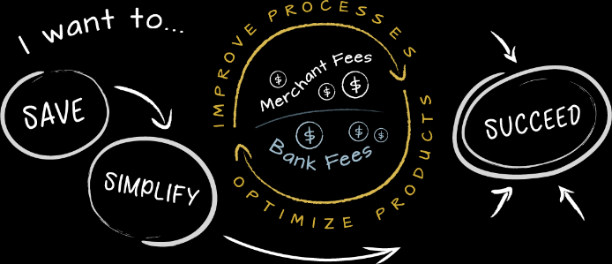
The Rapid Evolution of the B2B Payment Landscape

Slide 2
Agenda
Payment Systems: Overview
Current Environment - Six Core Payment Systems
Comparisons and Attributes
Shift in Payment Methods
Changing Payment Landscape
The Innovators in the Emerging Landscape
How the Consumer Space is Driving Innovation
The Crossover to B2C & B2B Payment Innovation
Emerging Technologies in the Payments Space
Goals
Challenges

Slide 3
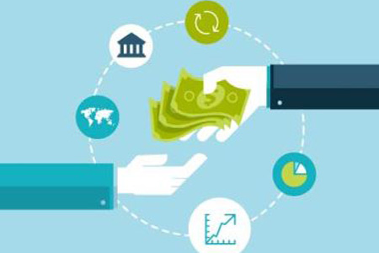
Payment Systems: Overview
A payment system is any system used to settle financial transactions through the transfer of monetary value.
Transfers Value
Institutions
Instruments
People
Rules
Procedures
Standards
Technologies
A common payment system is the operational network that links bank accounts and provides for monetary exchange using bank deposits.

Slide 4
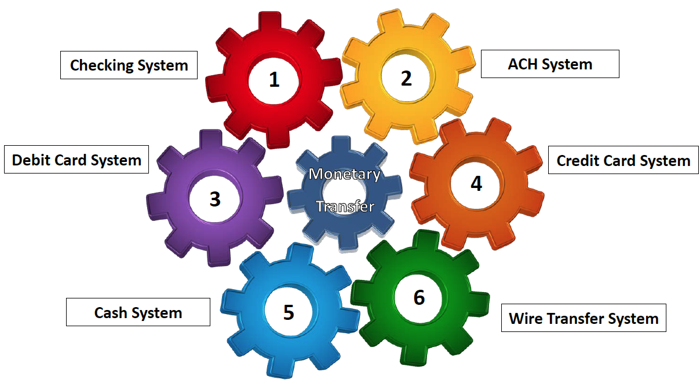
Current Environment - Six Core Payment Systems

Slide 5
Comparisons & Attributes - Six Core Payment Systems
Processing type – real time or batch
Closed or open loop system
Push or pull payment
Settlement processes
Timing and delays
Electronic or paper
Competitors and brands in the system
Extent of regulation in system
Economics and total cost of the system
Is interchange part of the system?
How does fraud protection work?
How complex are the system rules?

Slide 6
Comparisons & Attributes - Six Core Payment Systems
Payment System | Ownership | How It Operates | Risks
Checking | Banks and Private Processors | Intra-bank batch clearing by image primarily and some paper | Recipient bears the fraud and NSF risk
Credit Card | Publicly and privately owned networks | Real-time authorization and batch clearing. Known as a “pull’ payment | Recipient guaranteed good funds from most transactions
Debit Card | Publicly and privately owned networks | Real-time authorization and batch clearing. Known as a “pull’ payment | Recipient guaranteed good funds from most transactions
Cash | No Ownership | No transaction processing and no settlement. The only anonymous system and it has no rules | Recipient has minimal risk, risks can include counterfeit currency, theft and employee security
ACH | Bank Ownership | Electronic and batch processing. A “push” payment for the initiator and a “pull” payment for the receiver | Recipient bears the fraud, NSF/settlement risk
Wire Transfer | Fed Wire by FRB, CHIPS by its member | Real Time clearing and settlement. A “push” payment | Fully guaranteed payment, open to potential fraud risk through sharing of account information

Slide 7
Comparison of Payment Methods
Payment Method | Benefits | Limitations
Paper checks and manual payments | Most familiar Infrastructure in place Vendor controls timing Delays clearance | Very expensive, $8-$14 per check Manual processes High risk of fraud Float value now minimal
ACH | Inexpensive, less than .20/transaction Automated in ERP system Reduce manual workload Improve control and oversight Designed for repetitive and high volume transactions | Initial set up with ACH processor Bank account info required
Commercial Cards | Extended payment terms Rebate of financial incentives Robust remittance data Built in fraud and security Charge back rights | Recipient absorbs processing costs Requires initial set-up Requires IT investment Communication/marketing to payee/supplier base
Wire Transfers | Global coverage Occur in real time, reliable Immediate availability of funds High transactions values | Expensive Secure Limited ability to be reversed Not designed for high volume of payees

Slide 8
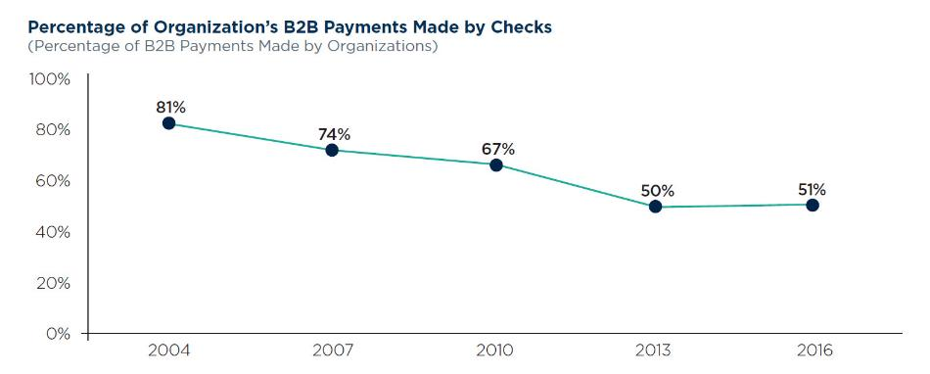
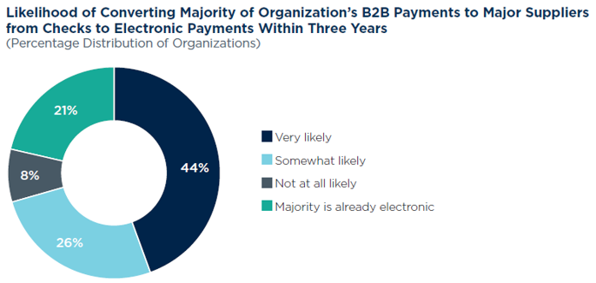
Shift in Payment Methods
51% of B2B payments were made by check in 2016
*2016 AFP Electronic Payments Survey
70% of businesses will shift majority of payments to electronic payments
21% are already significantly using electronic payments (e-payments)

Slide 9
The Innovators in the Emerging Landscape
Banks
Card Networks
Data Aggregators
Federal Reserve
Telcos/ Mobile Networks
Payment Networks
Government Legislation/ Regulation
Fintechs
Blockchain Developers

Slide 10
How the Consumer Space is Driving Innovation
Bill
Payments
Payment Technologies (e.g. Contactless, ApplePay)
Cryptocurrency (e.g. Bitcoin, Etherium, Ripple)
Consumer online Investment Platforms (e.g. Nutmeg, eToro)
Credit Scoring (e.g. ClearSource, FICO, TransUnion)
Lending and Cash Transfers (e.g. Even, Zelle, PayPal)
Mobile-only banking and mobile wallets
“Digital-first” users looking for end-to-end experience.
Consumer driven expectation leading to real-world products and capabilities in the commercial payments world.

Slide 11
The Crossover into B2C & B2B Payment Innovation
Real Time Payments
(RTP)
E-payments
Zelle
Same Day ACH
The need to keep pace with the Fintech disrupters is driving innovation through FI’s.
Speed, convenience and security are drivers.

Slide 12
Emerging payment methods
 | Same Day ACH | ePayments | Real Time Payments
Network | ACH | Zelle™ | The Clearing House (TCH)
Network Availability | Send transactions on business days (cutoff times apply) | Send Transactions ¹ 24x7x365 | Send transactions 24x7x365
Funds Availability | Same day | Within minutes )in-network) 1-3 days (out of network) ² | Within seconds
Type of Payment | Credit or Debit $25,000 limit per transaction | Credits Only Limits are based on recipient’s payment preference ³ | Credits only $25,000 to start
Finality | Reversals and returns allowed | Disputes may result in reversals and returns | Irrevocable
Status Visibility | Currently not available | Real-time | Real-time
Confirmation | Only if returned | Yes, end-to-end | Yes, end-to-end
Payee Information | Routing# + Account# | Email or mobile phone | Routing# + Account#
International Availability | NO | NO | Domestic U.S. transactions to start
1. ePayments is limited to business-to-consumer (B2C) transactions. Recipients can receive payments 24x7x365
2. Funds availability is dependent on whether the originator has enabled expedited payments and whether the recipient is able to receive expedited payments via an in-network bank or a debit card as an out-of-network user.
3. Transactions to recipients accepting funds on a debit card are limited to $50,000. Transactions to recipients accepting funds on a prepaid card are limited to $1,000.

Slide 13
Emerging Technologies in the Payments Space.
Emerging Technologies and Systems – both Domestic and International

Slide 14
The Goal
Well Governed
Efficient
Safe & Secure
Fast
Effective
Transparent
Governance
Authorization
Clearing
Availability
Settlement
Visibility
Legal
Ubiquitous
Competitive
Cost Effective
Implementation
Format
Comprehensive
Scalable
Exceptions
Accessible
Usable
Predictable
Contextual Data
Cross-Border
Multiple Use Cases
Framework
Proprietary Technology
Initiation
Authorization
Settlement
Security
Fraud
Privacy
Source: Federal Reserve Faster Payments Task Force Report, 2016

Slide 15
The Challenges
The payments landscape is changing at an accelerated pace which presents challenges to all of us who operate within that landscape:
Solutions will need to be integrated
Bank processing infrastructure has to change to support payment processing within seconds
New operating models for the management liquidity and cash application in virtually a 24x7 environment
Perpetual end of day processes such as Sweeps and ZBA

Slide 16
There is a shift coming, the landscape is being reshaped.
Ready or not - get prepared to change!

Slide 17
Q & A Thank You.

